Slide 1
CSL7090 Software & Data Engineering
Lecture #3
Course Instructors:
Sumit Kalra, Assistant Professor, IIT Jodhpur
Ram Subramaniam, Co-founder - My Money Karma
Google Classroom Code: cezptvv

Slide 2
MVC

Slide 3
MVC
Name | MVC (Model-View-Controller)
Description | Separates presentation and interaction from the system data. The system is structured into three logical components that interact with each other. The Model component manages the system data and associated operations on that data. The View component defines and manages how the data is presented to the user. The Controller component manages user interaction (e.g., key presses, mouse clicks, etc.) and passes these interactions to the View and the Model.
Example | A web-based application system organized using the MVC pattern.
When used | Used when there are multiple ways to view and interact with data. Also used when the future requirements for interaction and presentation of data are unknown.
Advantages | Allows the data to change independently of its representation and vice versa. Supports presentation of the same data in different ways with changes made in one representation shown in all of them.
Disadvantages | Can involve additional code and code complexity when the data model and interactions are simple.

Slide 4
Pipe-and-Filter

Slide 5
Pipe-and-Filter
Name | Pipe and filter
Description | The processing of the data in a system is organized so that each processing component (filter) is discrete and carries out one type of data transformation. The data flows (as in a pipe) from one component to another for processing.
Example | A pipe and filter system used for processing invoices.
When used | Commonly used in data processing applications (both batch- and transaction-based) where inputs are processed in separate stages to generate related outputs.
Advantages | Easy to understand and supports transformation reuse. Workflow style matches the structure of many business processes. Evolution by adding transformations is straightforward. Can be implemented as either a sequential or concurrent system.
Disadvantages | The format for data transfer has to be agreed upon between communicating transformations. Each transformation must parse its input and unparse its output to the agreed form. This increases system overhead and may mean that it is impossible to reuse functional transformations that use incompatible data structures.

Slide 6
Client-Server

Slide 7
Client-Server
Name | Client-server
Description | In a client–server architecture, the functionality of the system is organized into services, with each service delivered from a separate server. Clients are users of these services and access servers to make use of them.
Example | An example of a film and Video/DVD library organized as a client–server system.
When used | Used when data in a shared database has to be accessed from a range of locations. Because servers can be replicated, may also be used when the load on a system is variable.
Advantages | The principal advantage of this model is that servers can be distributed across a network. General functionality (e.g., a printing service) can be available to all clients and does not need to be implemented by all services.
Disadvantages | Each service is a single point of failure so susceptible to denial of service attacks or server failure. Performance may be unpredictable because it depends on the network as well as the system. May be management problems if servers are owned by different organizations.

Slide 8
Peer-to-Peer

Slide 9
Peer-to-Peer
Name | Peer-to-peer
Description
Example
When used
Advantages
Disadvantages

Slide 10
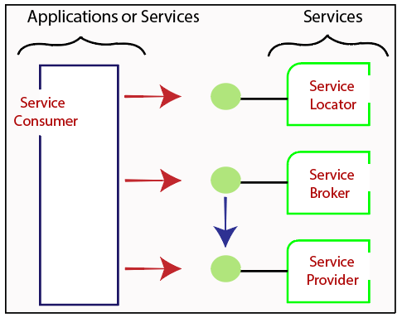
Service Oriented Architecture

Slide 11
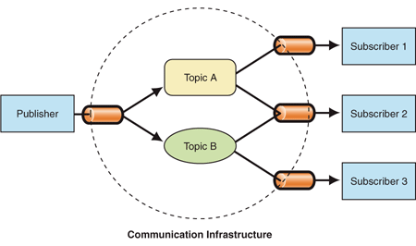
Publisher-Subscriber Pattern

Slide 12
Aren’t Publishers providing services to Subscribers? If Yes, how is it different from SOA?

Slide 13
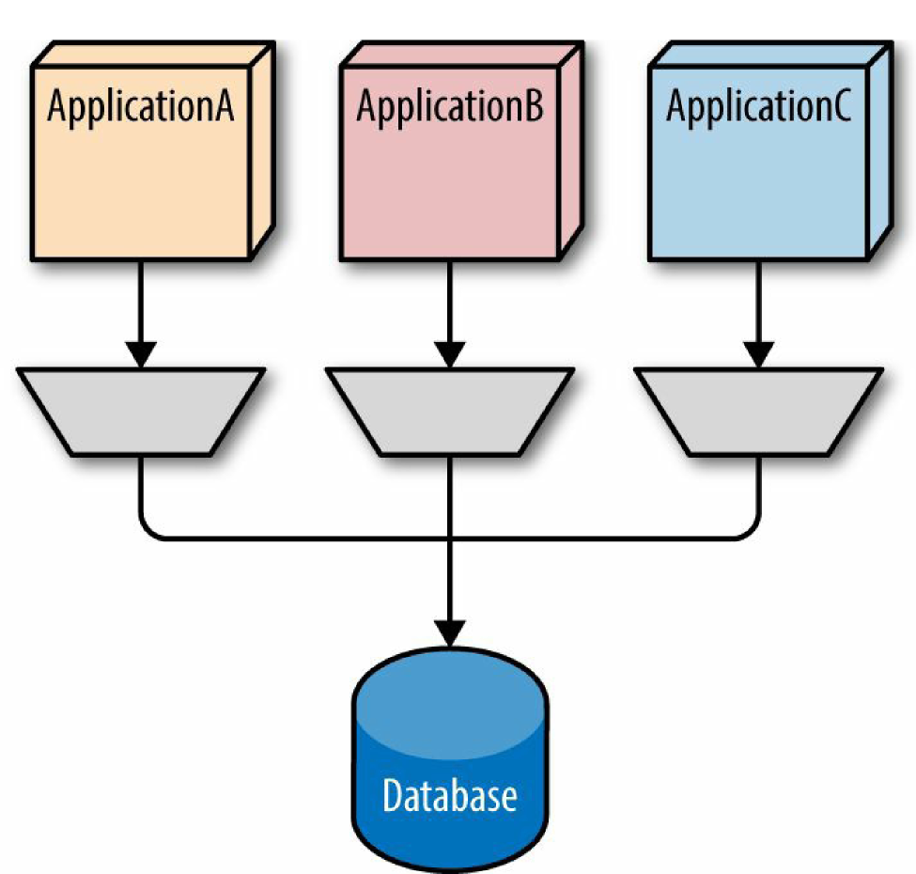
Shared Data Pattern

Slide 14
Multiple Subscribers are using common set of Publishers. How is it different from Shared Data Pattern?

Slide 15
4+1 Architectural Views
A logical view, which shows the key abstractions in the system as objects or object classes.
A process view, which shows how, at run-time, the system is composed of interacting processes.
A development view, which shows how the software is decomposed for development.
A physical view, which shows the system hardware and how software components are distributed across the processors in the system.
Related using use cases or scenarios (+1)

Slide 16
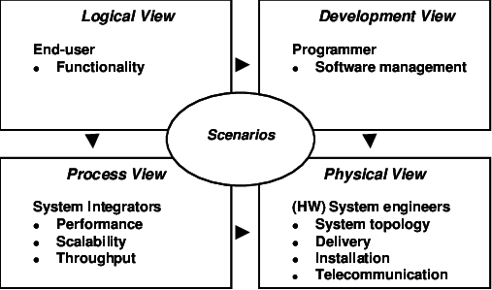
Original 4+1 View Model Proposed by Kruchten (1995)

Slide 17
Example of 4+1 Views

Slide 18
Homework:
Microservice Architecture
Modular v/s Monolithic Software Design
4+1 Views
Next Class: Basic web architecture/CICD Intro - Dr Ram
Contact: sumitk@iitj.ac.in

